Slide 1

welcome
to Lecture 4

Slide 2
Computation and the Brain

Slide 3
First: What happened last Wednesday

Slide 4
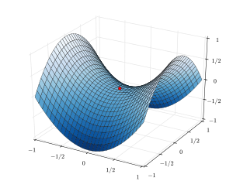
Why does gradient descent succeed in approximating the optimum?*
saddle
points

Slide 5


How does SGD avoid overfitting*? “Understanding deep learning requires rethinking generalization” ICLR 2017; also, cf T. Poggio I, II, III 2017
project alert!
no overfitting

Slide 6
The Johnson – Lindenstrauss Lemma (JLL): The Moral
for any data set
if the dimensions have no special meaning for you
and you are mainly interested in the distances between the data
and you can tolerate an error of 𝛆
then your dimension should not exceed 8 ln n/𝛆²

Slide 7
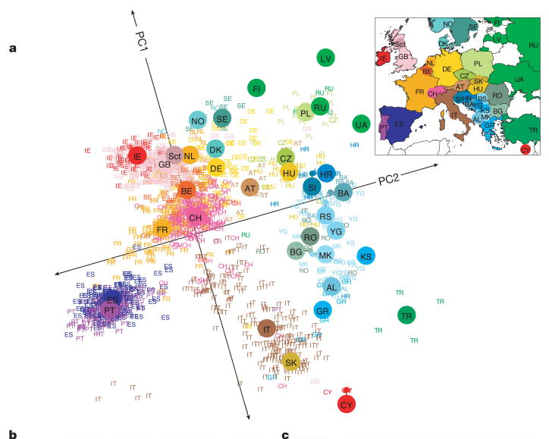
PCA of DNA: n = 3,000 d = 500,000, k = 2

Slide 8
To find the k largest eigenvectors of symmetric matrix A
Starting from a random vector x compute the sequence of (normalized to 1) vectors Ax, A²x, A³x, etc, until it converges to v₁
v₁ is the first eigenvector (the one corresponding to the largest eigenvalue)
Now project the matrix to the space orthogonal to v₁ and repeat to find the second eigenvector. And so on, k times.
Fast matrix multiplication version (A A² A⁴ A⁸ …)
Works as long as the eigenvalues are well separated. Otherwise, just a little more complicated…
Alternative: singular value decomposition (SVD)

Slide 9
Sparse coding: Algorithms
Gradient descent [Olshausen Fields 1998]
Maximum likelihood, assuming a generative model and noise [Lewicki and Sejnowski 200]
Alternating minimization:
Start with a basis B
Repeat: Sparse decode the data on B to get x
Gradient step on B
Performance guarantees, see [Arora et al 2015]

Slide 10
Questions? Thoughts? Feedback?
Thalamus? Rethinking Gen?
von Neumann?

Slide 11
Today
Synaptic connectivity
Synaptic plasticity
Plasticity in neural nets
Next Wednesday: Information Theory, the Brain, and DNNs

Slide 12
The Brain: a Uuuuuuge directed graph
About 10¹¹ neurons
Between 10¹⁴⁻¹⁵ synapses
Notice: this means that every neuron has on average 1000 – 10,000 presynaptic neurons, and again as many postsynaptic ones
A random graph?

Slide 13
A well known random graph
G_{n,p} or the Erdo”s – Renyi random graph [1959]
n nodes
Prob [edge I → j] = p independently of other pairs
hence, in-degree or out-degree concentrated at pn
p < 1/n: dwarf components ~ln n
1/n < p < ln n/n: a giant component, still disconnected
p > ln n/n: connected.
Sharp thresholds
e.g., Clique: 2ln n/ln(1/p)

Slide 14
Another well known random graph
P_{n}^{𝛼} power-law (or Internet-like) graph
Undirected
Prob[there is a node of degree d] ~ n ^{-𝛼d}
Internet, www: 𝛼 ~ 2.6 - 2.8
Or: generated by some preferential attachment process (“the rich get richer”)

Slide 15
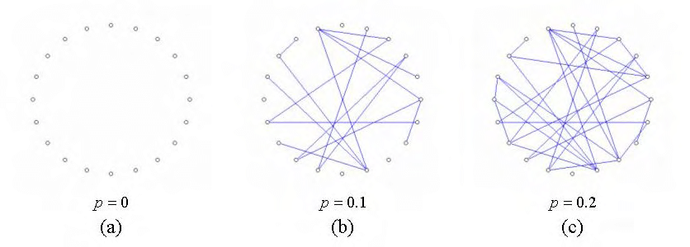
Erdo”s – Renyi graphs

Slide 16
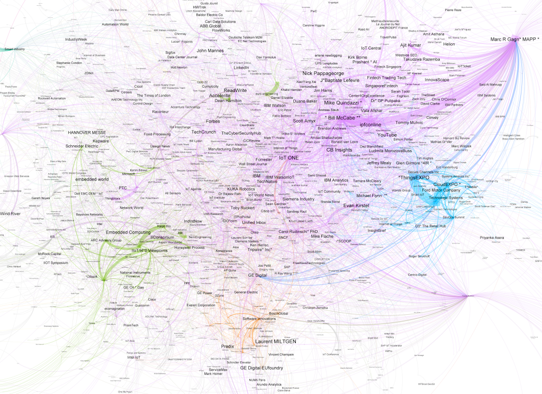
Power law / Internet like graph

Slide 17
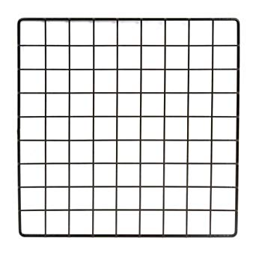
Btw, a third kind of brain-relevant graph: The small world graph [Kleinberg 2000]
A grid (2D geometry!)
Plus from each node
very few random edges
Going distance d away
with probability ~ d⁻²
Theorem: Greedy algorithm routes in very few steps

Slide 18
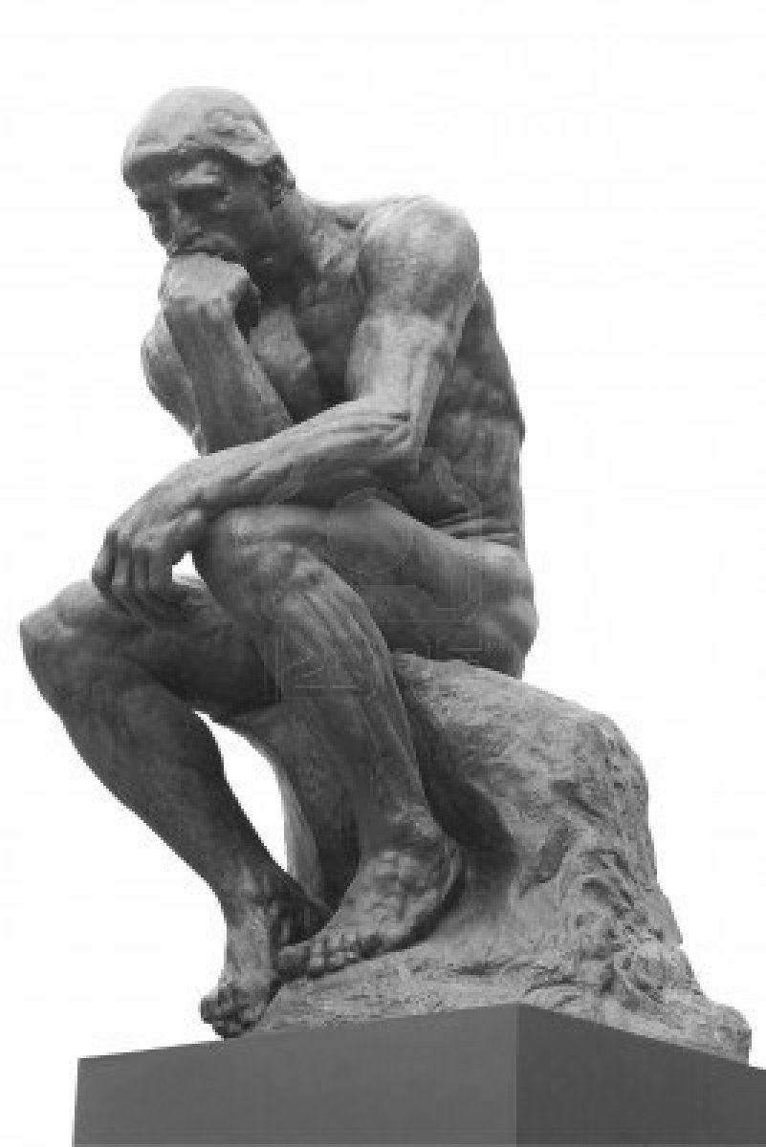
Which of these kinds of random graphs is the brain more like?

Slide 19
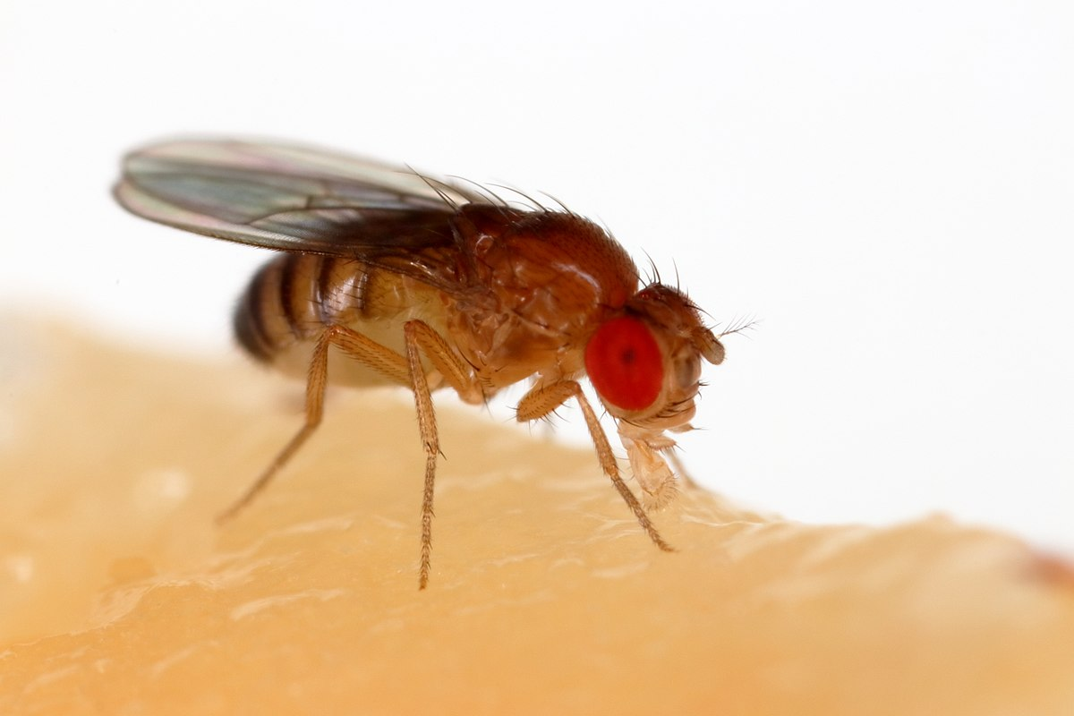
To start with, in what sense is it random? Can brain connections be random?
An answer from a place very far in the animal phylogenetic tree

Slide 20
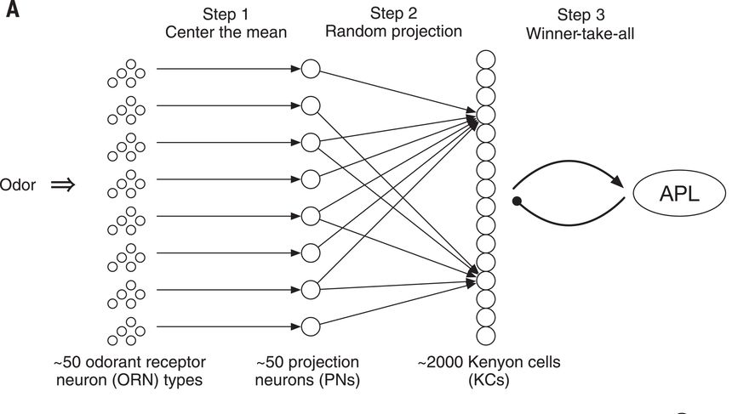
How fruit flies remember smells
random
projection
followed by cap (RP&C):
100 winners
(out of 2000)
take all

Slide 21
How fruit flies remember smells
Q: but wait a minute! Is this
a random
bipartite
graph?

Slide 22
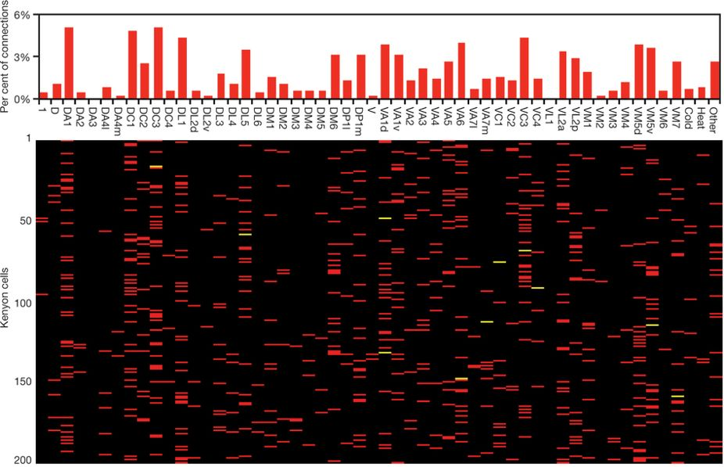
A: Random convergence of olfactory input in the Drosophila mushroom body by S. Caron, V. Ruta, L. Abbott, R. Axel,2013
Bottom line:
looks like a random bipartite graph,
except that the degree distribution
of the LHS is not uniform

Slide 23
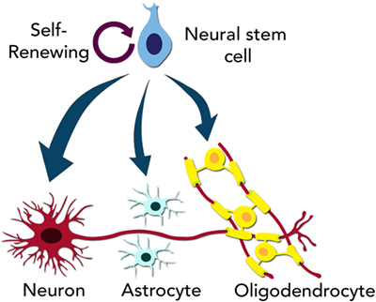
What is the generative model of the Human Connectome?
Neurons are created from
stem cells
2. They sprout dendrites and an
axon hillock (basis)

Slide 24
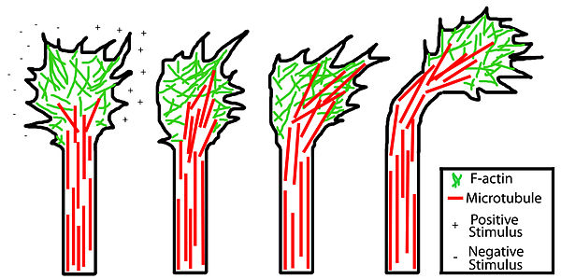
What is the generative model of the Human Connectome?
3. Then the axon’s growth cone takes over
A sensory – motor organ
Navigates the brain
following chemical cues
(advance, turn, stop)

Slide 25
How long does the growth cone travel?
Many yards in the giraffe
Some 𝝻m in local circuits, or for most inhibitory neurons (exponentially concentrated to zero)
About 4mm on average in the cortex

Slide 26
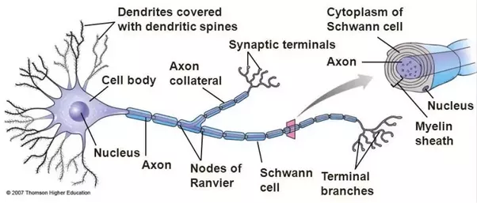
Many navigational strategies
sometimes there are early scaffold neurons
other times there are signpost neurons
advance, turn, stop: Q: is there a split?
axon collateral

Slide 27
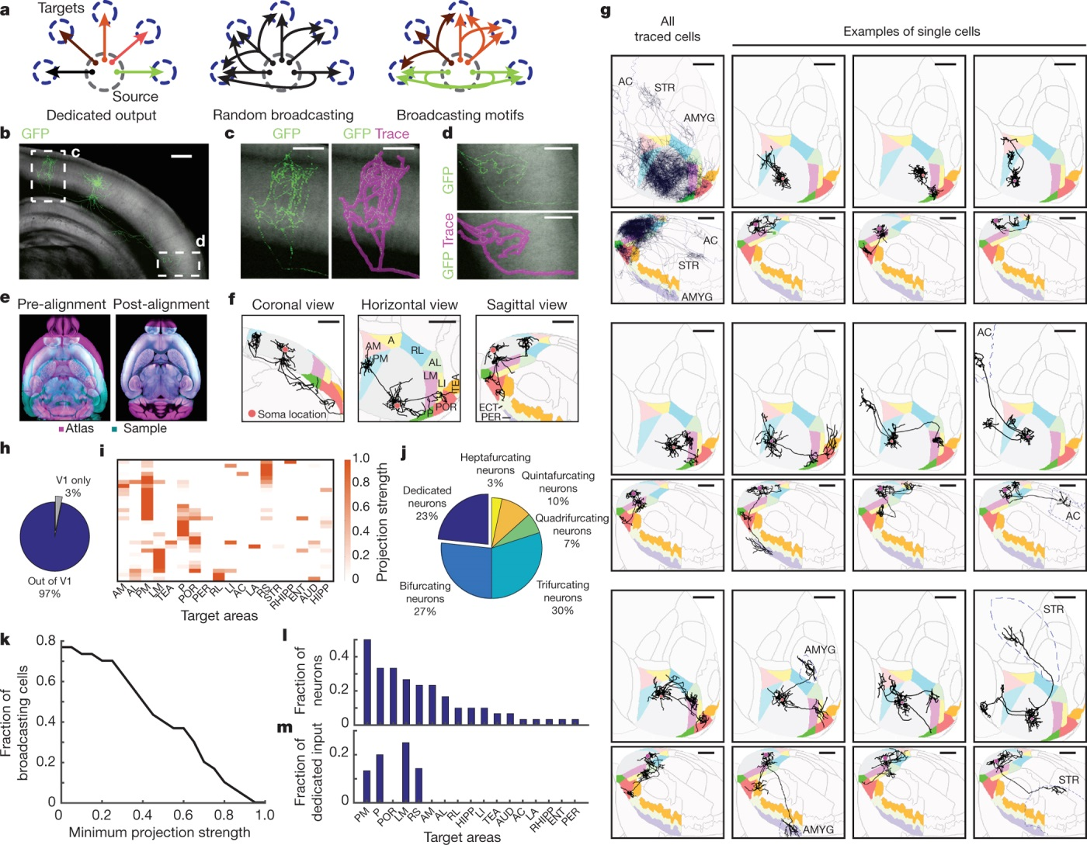
Brain-wide single-cell tracing reveals the diversity of axonal projection patterns of layer-2/3 V1 neurons,with most cells projecting to more than one target area
Y Han et al. Nature 556, 51–56 (2018) doi:10.1038/nature26159

Slide 28
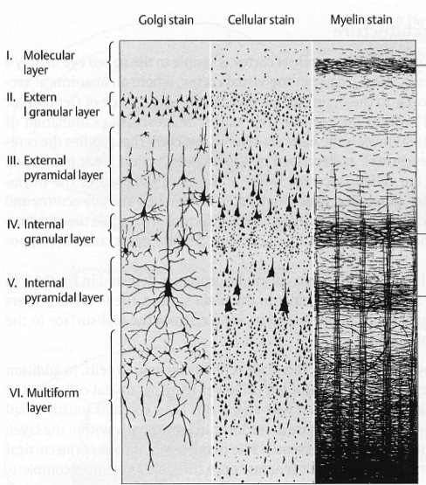
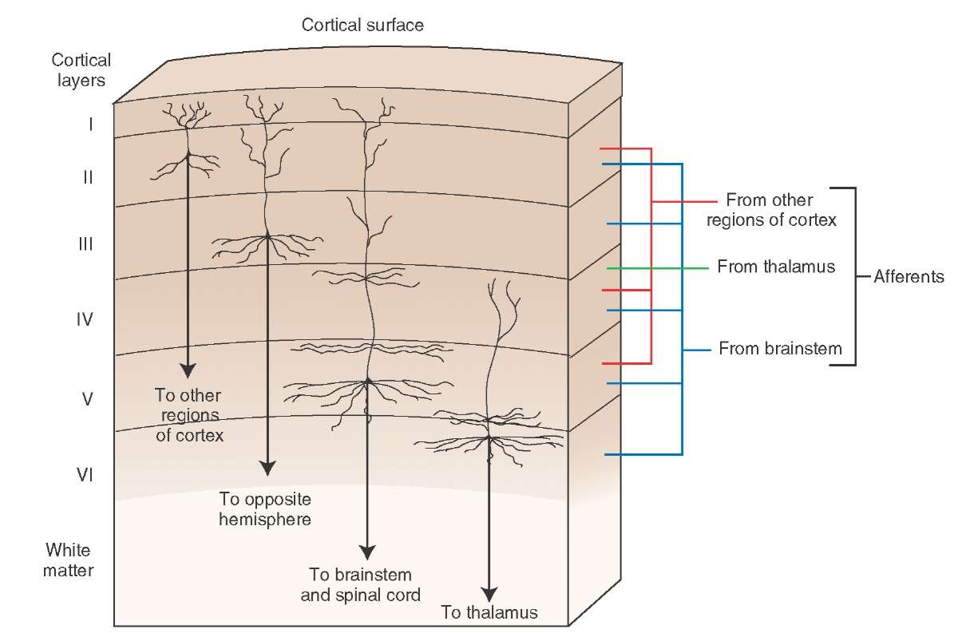
(Cerebral) Cortex: the engine
1.5 mm
2500 cm²
six layers
20B neurons

Slide 29
So, there is a split… and it seems to be important

Slide 30

Connectome (as in “you are your _”)

Slide 31
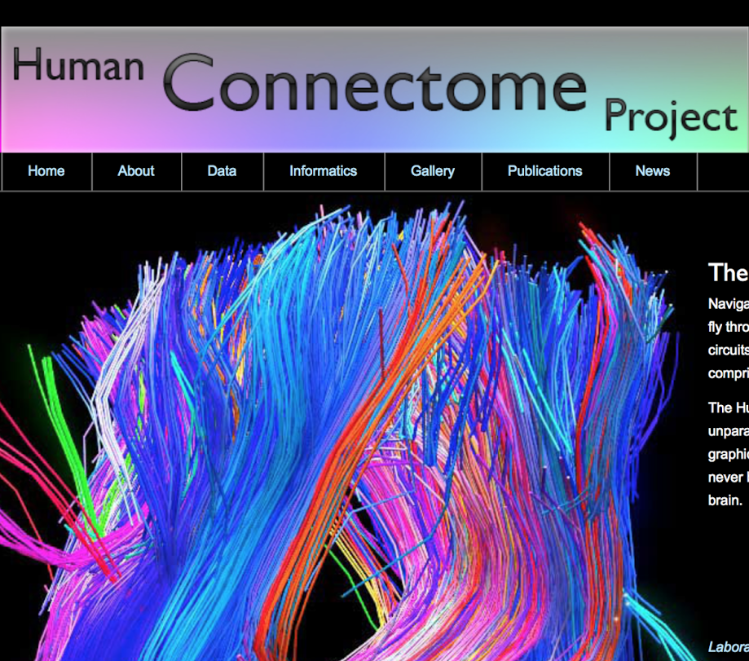

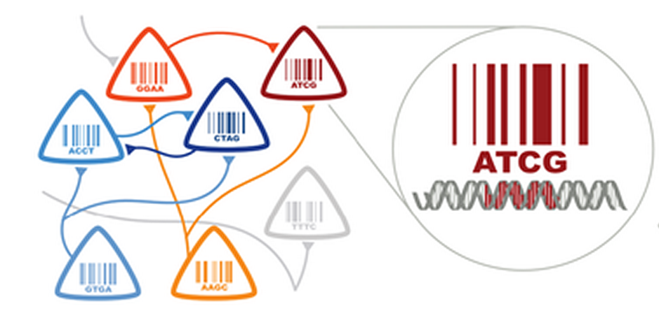

Slide 32
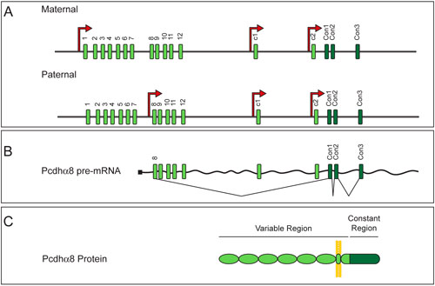
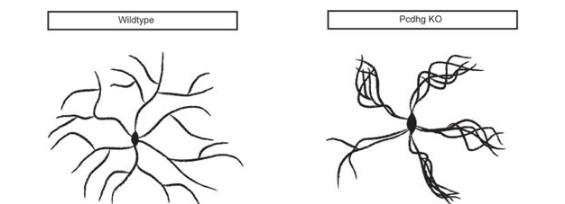
Speaking of bar codes… Protocadherin proteins and molecular self-avoidance

Slide 33
Question
Suppose we have the human connectome
Will it help us understand how the brain works?

Slide 34
So, what kind of graph is the connectome? One hypothesis: Locally Erdo”s – Renyi and globally Internet-like

Slide 35
So, what kind of graph is the connectome? Two-way connected neurons
Two-way connection between two neurons is about ten times more likely than Erdo”s – Renyi predicts
“Highly Nonrandom Features of Synaptic Connectivity in Local Cortical Circuits”
S. Song et al., PLOS Bio 2005

Slide 36
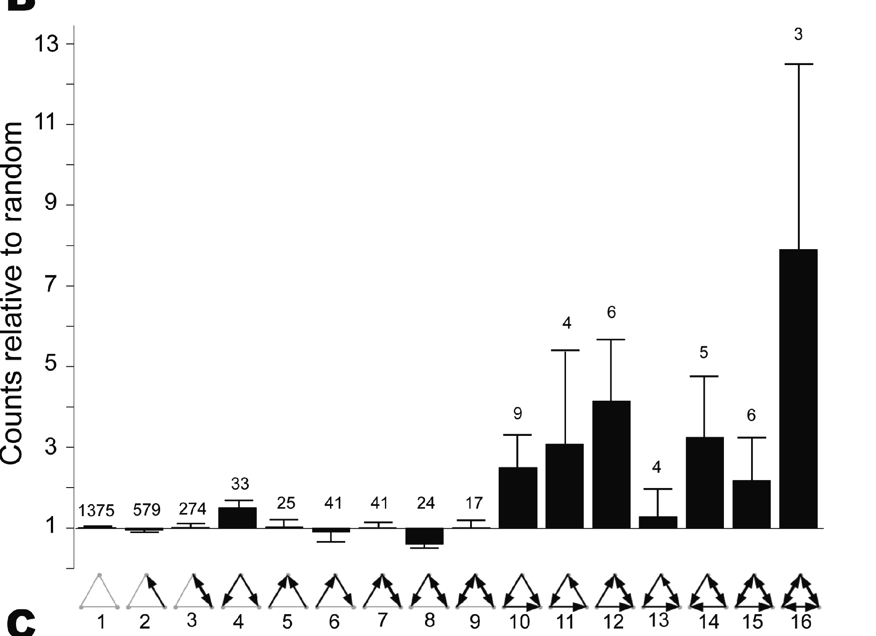
So, what kind of graph is the connectome? Three neuron connectivity
“Highly Nonrandom Features of Synaptic Connectivity in Local Cortical Circuits”
S. Song et al., PLOS Bio 2005

Slide 37
Why is that? *
Geometry?
“Independently Outgrowing Neurons and Geometry-Based Synapse Formation Produce Networks with Realistic Synaptic Connectivity”
van Ooyen et al. PLOS 1 2014
Or plasticity?
cf H. Markram V2 cells responding to the same edge direction are much more likely to be connected

Slide 38
Your connectome changes (…but so do you…)
New connections are formed
In the embryo
In the baby
In the adult
Existing ones are destroyed

Slide 39
Number of synapses (into muscular fibers)
birth!
time

Slide 40
How is this deletion done?
cf algorithmic work on graph sparsification, [Spielman and Teng 2004] and others*

Slide 41
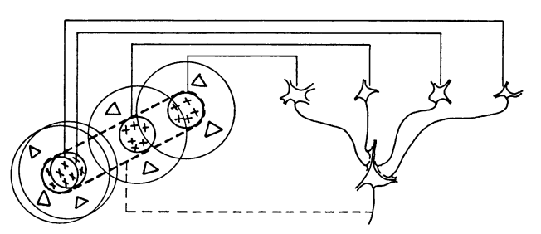
Incidentally, remember Hubel and Wiezel’s simple cells?
How are these synapses formed?
How do all these ganglia know that
they are on a straight line in the retina? *
Was it evolution?
Is it done during development?
Or is it learning and synapse deletion?

Slide 42
Btw: yet another thing to consider*
An axon can touch the postsynaptic dendrite at many places
At many “edges of the tree”
How do these add up to effect the postsynaptic neuron?
Sup of products? Products of sums?
Much work is done on this front…

Slide 43
Connections between neurons are not permanent
New ones are formed
In the embryo
In the baby
In the adult
Existing ones are destroyed
Existing ones become stronger or weaker at a large range of time scales (1ms to months)
Plasticity: the way brains learn

Slide 44
Pre-synaptic activity affects the magnitude of post-synaptic response

Slide 45
History of plasticity
1890: Ramon y Cajal hypothesizes that synapses between neurons are the agents of learning
1949: Hebb’s rule: “Neurons that fire together wire together”
1966: Lomo observes long term potentiation (LPT) in the rabbit brain
1970s: Long term depression (LTD) is observed
1980s: The biochemical basis of plasticity: Ca⁺⁺ and NMDA receptors
1986: Backprop: software plasticity through SGD
1995: Spike timing dependent plasticity (STDP)
where does
this fit?

Slide 46
Models of plasticity
Mathematical, black box models
Spike timing models
Biochemical/physiological models of plasticity
Plasticity seems to have to do with Ca⁺⁺ and NMDA receptors
Spine shape change, as well as spinogenesis, may affect plasticity
Latest: MNDA receptors move to enhance plasticity (at the 1ms scale…)

Slide 47
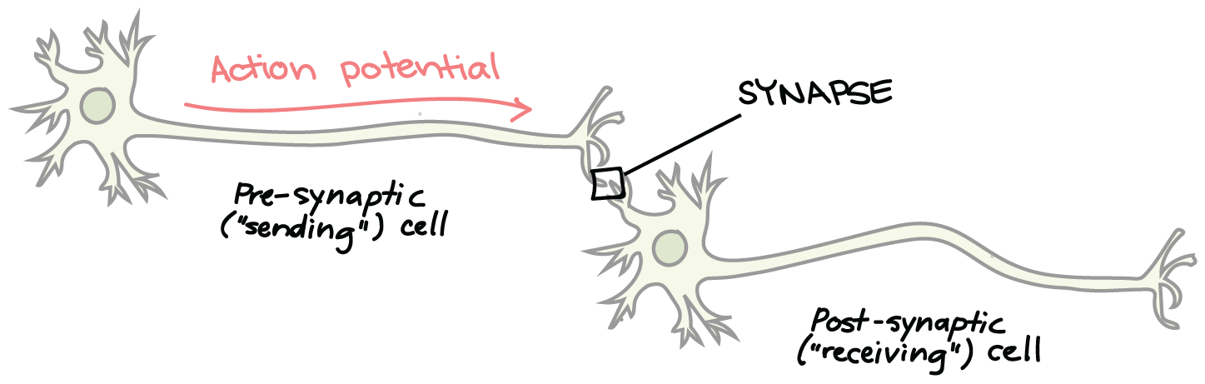
Models of plasticity
w
x
y
Hebb: 𝚫w ~ x y
Vector Hebb: 𝚫W ~ X y (X vector of presynaptic neurons)
Covariance form of Hebb (assuming y is the average input times W): 𝚫W ~ cov[X] W
Hebb with LTD: 𝚫W ~ X (y – ϑ) – but then LTD if y = 0
BCM rule corrects this: 𝚫W ~ X y (y – ϑ)
Homeostasis, normalization and competition: at a slower time scale, the sum of all presynaptic weights is renormalized to 1

Slide 48
Models of plasticity: Plus: Homeostasis, normalization and competition
Homeostasis means that the organism is stable, its parameters stay in check and its resources are not depleated.
For example, inhibition makes sure that not all neurons fire at the same time
Q: So, what mechanism makes sure plasticity does not cause synaptic weights to become infinite?
A: at a slower time scale, the sum of all presynaptic weights is gradually renormalized to one
Note that this begets competition between presynaptic cells

Slide 49
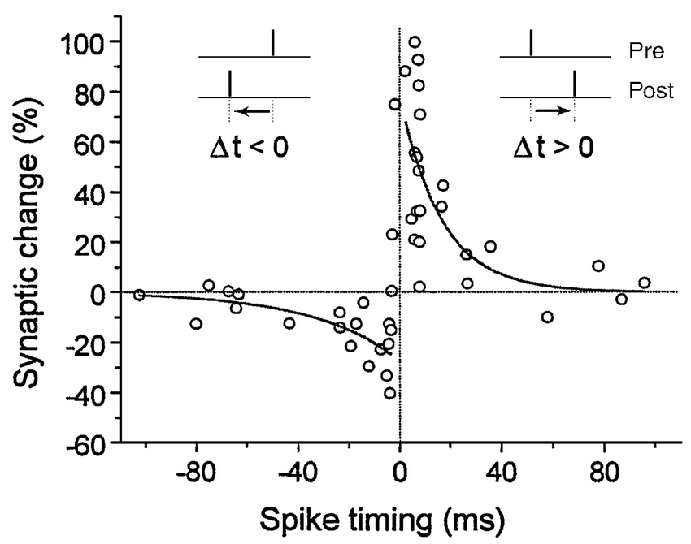
Spike timing-dependent plasticity (STDP)
If spike arrives in time, some
gain. Just in time, big gain.
If it just misses it, some loss.
Just misses it, big loss.

Slide 50
Btw: Hebb’s exact words
Rhyming soundbite: “fire together, wire together”
Actual quote from [Hebb 1949 The Organization of Behaviour]:
“When an axon of cell A is near enough to excite cell B or repeatedly or persistently takes part in firing it, some growth process or metabolic change takes place in one or both cells such that A’s efficiency, as one of the cells firing B, is increased.”
NB: “or both cells” is an impossibility

Slide 51
Spike timing-dependent plasticity (STDP)
If spike arrives in time, some
gain. Just in time, big gain.
If it just misses it, some loss.
Just misses it, big loss.

Slide 52
Wow! What does this mean?

